Slide 1
CIEVS: A Cloud-based Framework to Modernize the Indian Election Voting System
Presented By:
Gurpreet Singh Matharu

Slide 2
INTRODUCTION
India being the world’s largest democratic nation, holding free and fair elections has always been a herculean task; still the Election Commission of India has been discharging its constitutional duties very efficiently. In India, the Information and Communication technologies (ICT) are being deployed in all the sectors including media, health, agriculture and education. Although, the Election Commission of India has rolled out a slew of e-initiatives, but the maximum potential of ICT yet remains to be exploited.
Upon statistical analysis of voting percentages recorded for the Indian Elections since Independence, an astonishing fact emerges that the voting percentages have remained between 55% and 65% for the combined total of female and male voters. These exceptionally low voter turnout percentages do not augur well for a vibrant and robust democracy. The existing Indian election voting system necessitates the electorate to visit the designated polling booth and be authenticated before they are allowed to cast their votes through Electronic Voting Machine (EVM) Systems. This makes the entire voting process very time-consuming for the voters.
Gradually, the wireless Internet penetration across the country has seen a significant growth, thus enabling the introduction of Internet Voting (I-Voting) to boost the election voting percentages. I-Voting is defined as remote form of electronic voting (e-voting) where voting right is exercised at the voter's sole discretion, in absence of physical supervision by government representatives. I-Voting includes voting from one's Internet – enabled personal computer, laptop or smart phone.

Slide 3
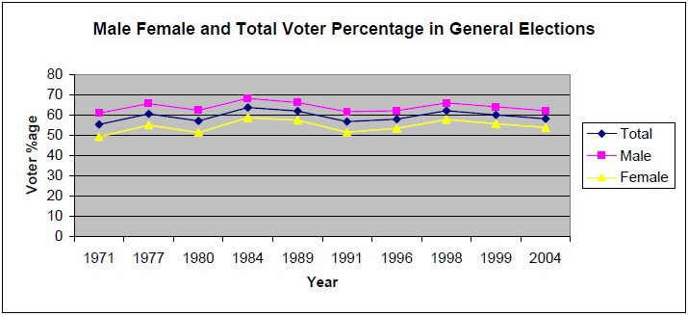
INTRODUCTION
The Election Commission of India has recently taken up several ICT-based initiatives; one of them being digitization of electoral rolls, that has resulted into generation of mammoth databases at their disposal. Further, the Commission has introduced an Online Voter Enrolment process which allows an eligible voter candidate to apply for voter card on the Commission’s website, thus providing the citizens with an easier and simpler voter enrolment method. But, increased adoption of advanced ICT technologies needs to be encouraged to realize the maximum potential of ICT in order to boost the voting percentages.
We have proposed an I-Voting System aiming to provide a solution to the prevailing low election voting percentages. Further, we propose a conceptual deployment framework referred to as “Cloud-based Integrated Election Voting System (CIEVS)” by leveraging advanced ICTs, especially cloud computing technology for successful implementation of I-Voting System. As the name suggests, this model integrates the existing EVM System with the I-Voting System. The model aims to boost the voting percentages among the citizens by providing them with a convenient option to cast their votes through the I-Voting channel.
Fig. 1. Male Female and Total Voter Percentage in General Elections [1]

Slide 4
LITERATURE REVIEW
Chris Armen identifies and discusses few of the main vulnerabilities and issues in Electronic Voting Machines (EVMs) and concludes that the EVMs must be verifiable and their hardware design as well as source code should be made transparent to the public.
Mayur Patil has conducted a survey of all available voting systems including Paper Ballot System, Electronic Voting Machine (EVM) System, Online Voting System, SMS Voting through mobile phones. The author, after a comparative study of all the voting systems concludes that there is a pressing need for developing a new voting system that combines the advantages of all the existing voting systems, overcoming the drawbacks of all those voting systems.
Dimitrios Zissis explores the notion behind the term cloud computing and evaluates its relevance to e-government services, particularly e-voting information systems. Further, the author proposes architecture for e-government and e-voting systems by leveraging cloud computing technology and cryptographic technologies.
Ashutosh Gupta puts forward an e-voting model based on cloud computing technology, including the integration of Aadhar Card database with e-voting system. The author states that cloud computing would fasten up the e-voting system due to its new architecture and security offerings.

Slide 5
UTILITY OF CLOUD COMPUTING IN I-VOTING
Cloud computing technology simplifies the delivery of IT services, without the need of users being aware of the underlying architecture and complexities. Also, the cloud services may be accessed at any time and from any location. The key characteristics of cloud include availability, flexibility, elasticity, resource pooling, multitenancy, reliability and scalability of resources and services. Thus, cloud computing, if deployed and implemented successfully can extend the following benefits to I-Voting System:
Cloud computing utilizes super computing power to execute billions and trillions of computations per second. In I-Voting System, millions of votes would be casted in a single day, thus cloud stands out to be the most appropriate technology to be leveraged for successful implementation of I-Voting System.
Cloud technology is capable of analyzing huge databases, thus allowing for validation of millions of I-Voters, besides collecting and tallying their votes in centralized database of Election Commission of India.
Cloud computing offers rapid computing power besides providing location independent platform using Internet services so as to enable a voter to access the I-Voting Web Portal at anytime from any location to cast his or her online vote .
Cloud technology is capable of providing quality services even when the system is experiencing peak load by using additional servers and resources. Further, cloud computing supports mechanisms for allowing distribution of load among the available resources.

Slide 6
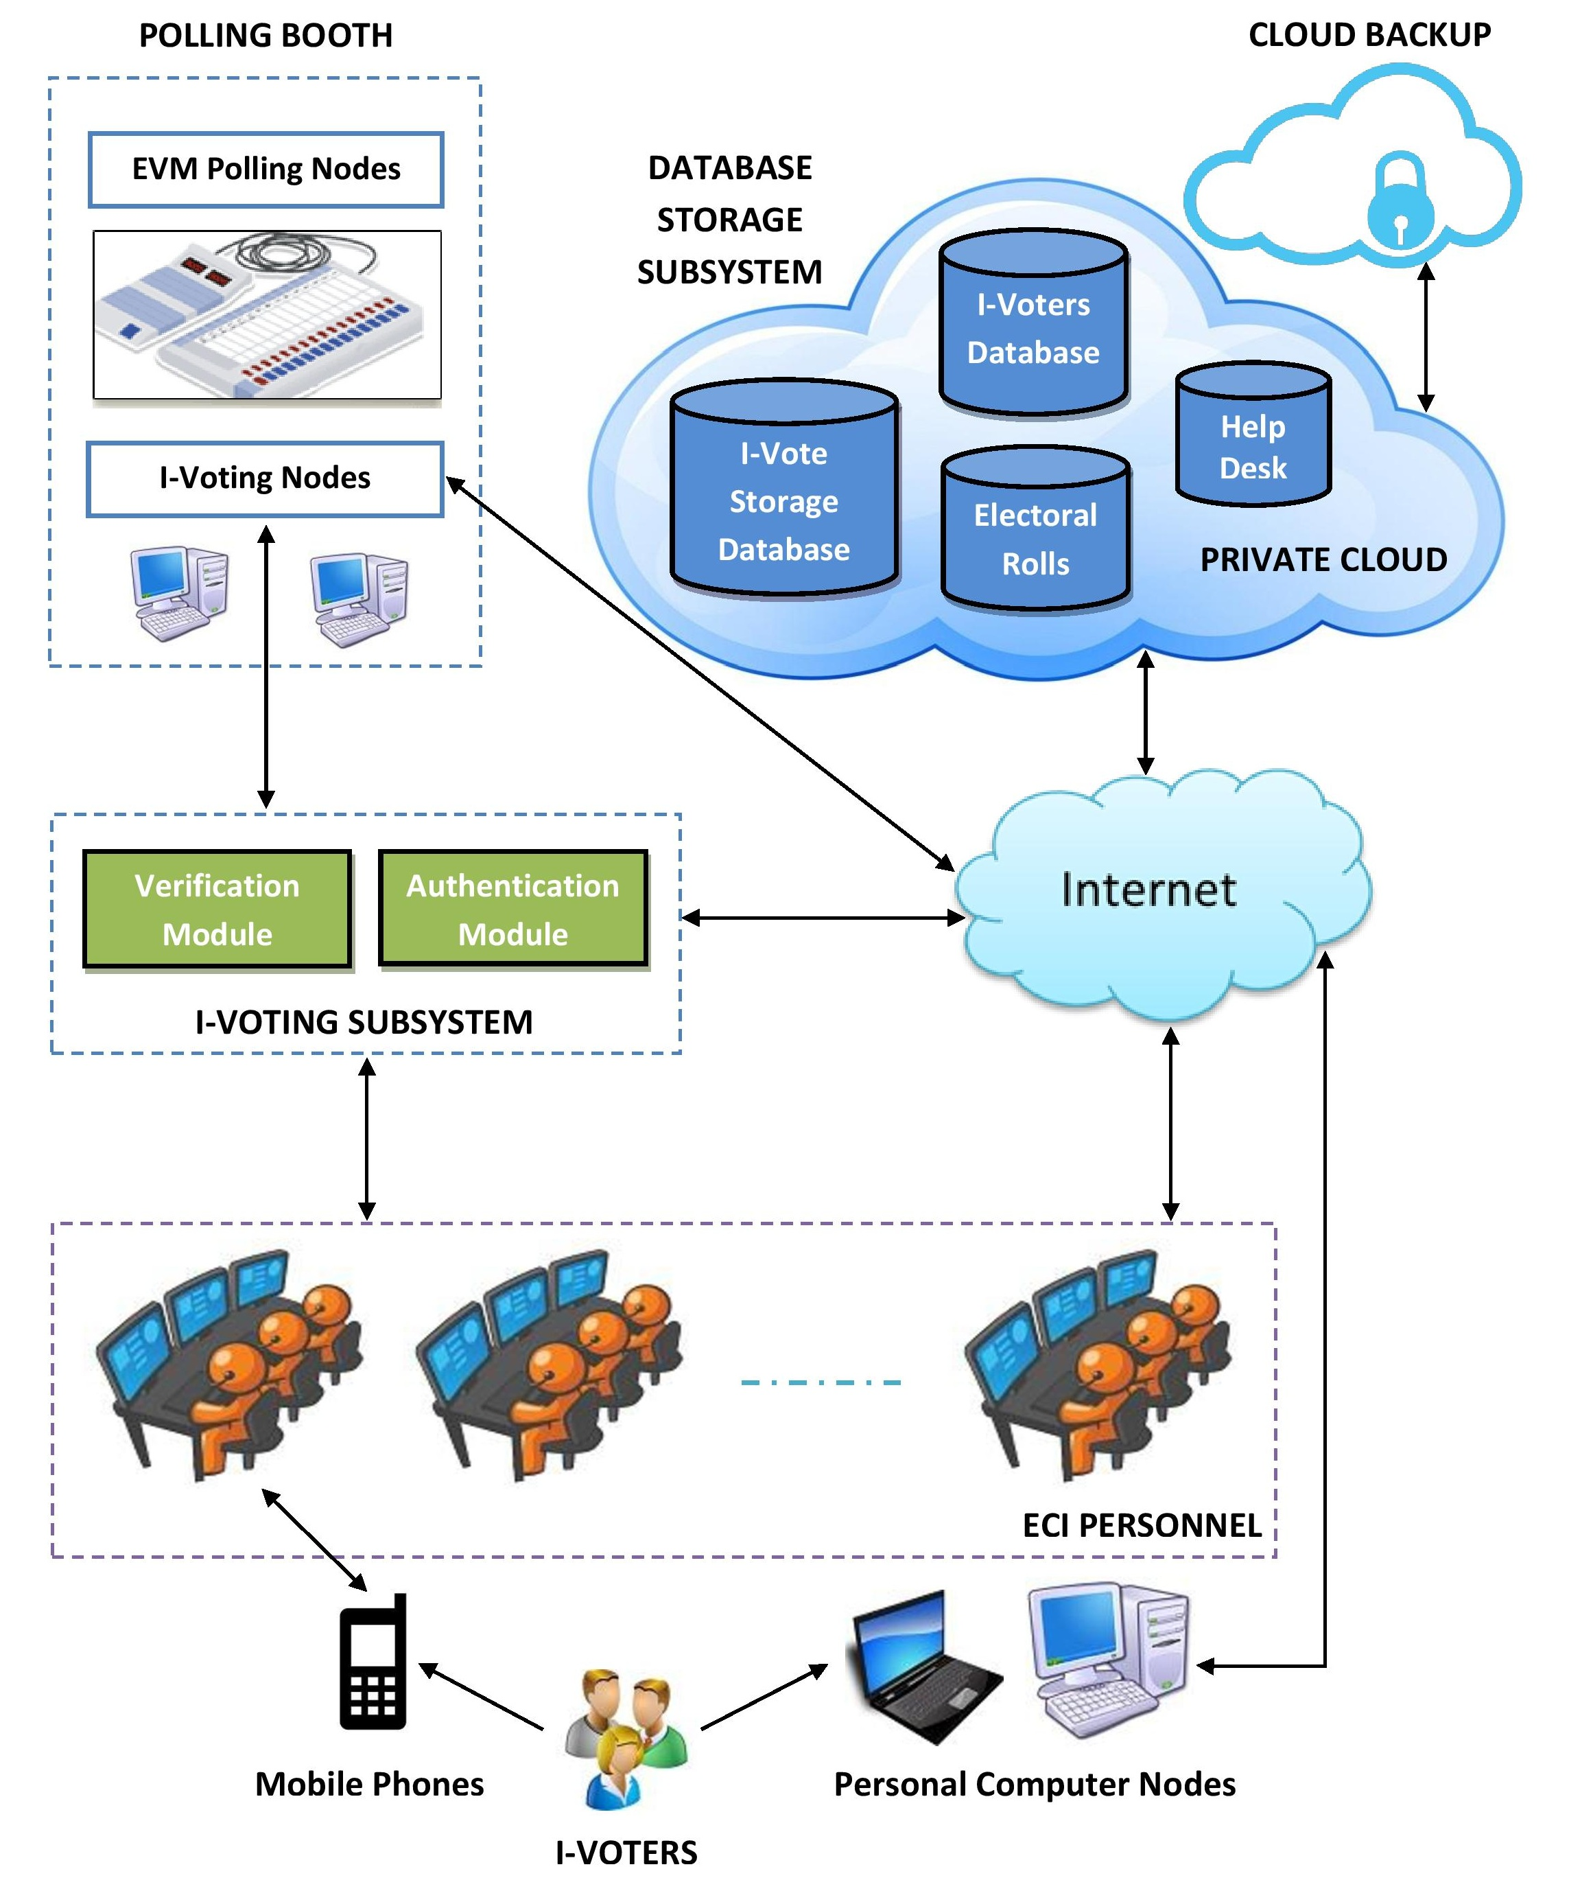
PROPOSED MODEL FOR I-VOTING
Fig. 2. Model Architecture for CIEVS

Slide 7
PROPOSED MODEL FOR I-VOTING
The proposed model is a theoretical deployment model referred to as “Cloud-based Integrated Election Voting System (CIEVS)” which leverages advanced Information & Communication technologies, including cloud computing, web services and mobile phone services for successful implementation of I-Voting, besides creating and maintaining central databases for storage of I-Voter records and online votes being cast during election.
The prime objective of the proposed model is to extract the indirect benefits of implementing advanced ICT tools in the Indian election voting scenario. As the name suggests, this model provides for integration of existing Electronic Voting Machine (EVM) System and I-Voting System through the deployment of cloud computing.
The CIEVS model comprises of five components, Database Storage Subsystem, I-Voting Subsystem, Polling Booth, ECI Personnel and Interface Devices.

Slide 8
A. Database Storage Subsystem (DSS)
The proposed model inculcates the technological benefits of cloud computing for modernization of the Indian election voting system. To achieve this goal, DSS is implemented as a private cloud with the ownership rights lying exclusively with the Election Commission of India (ECI). The private cloud would offer platform as a service (PaaS) to store all the data that can be accessed solely by the ECI. Further, cloud virtualization technology would ensure the creation and regular updation of cloud data backup and allow for restoration, if data loss occurs. The DSS contains the following databases:
1) Electoral Rolls: It is known that the Election Commission of India has recently computerized the electoral rolls, resulting in huge databases at their disposal.
2) I-Voters Database: To achieve the objectives of proposed I-Voting, a centralized and efficient database is required to store and manage the records of millions of I-Voters.
3) I-Vote Storage Database: As the I-Voters from all over the country would cast their votes through the Web Portal, their votes would be stored in an encrypted form in a central database termed as I-Vote storage database. Also, the final counting/tallying of online votes would be performed based on this database, thus facilitating the vote counting process as well.
4) Help Desk: This database stores and provides the solutions to common issues and frequently asked questions by the I-Voters.

Slide 9
B. I-Voting Subsystem
The I-Voting Subsystem contains two sub-components:
1) Verification Module: The model incorporates a two-step verification process to verify the identity of applicants during the registration phase. First being verification through online means and second being physical verification conducted by field verification personnel of Election Commission by visiting the applicant’s residence. The online verification module is implemented by asking the applicants to submit a prescribed set of documents through the I-Voting web portal which would be processed for verification. Further, the user is asked to register an email address and mobile phone number. The Web Portal is integrated with SMS gateway to send One-Time Password (OTP) code on the applicant’s mobile phone number and then that code is compared with the code filled in the verification module.
2) Authentication Module: The Web Portal for I-Voting would require the I-Voters to login into their accounts through a set of username and password generated during the registration phase. The authentication module would check if the login details entered by the voter actually match with any of the existing accounts. If it successfully matches, the voter gets access to his or her account. Then, this module follows a two-step authentication process to authenticate the identity of voters during the voting phase. First, the voter is authenticated through the registered email address by sending a verification web link to it and asking the voter to click on that web link to proceed to the E-Ballot paper. After choosing a candidate, the voter is required to authenticate the second time by providing the correct One-Time Password (OTP) code as sent onto his or her registered mobile phone number before final submission of online vote.

Slide 10
C. Polling Booth
In existing election voting setup, the polling booths are equipped with Electronic Voting Machines (EVMs). The proposed model provides for inclusion of I-Voting nodes within the premises of polling booths as well.
1) EVM Polling Nodes: At present, votes are being casted through the use of Electronic Voting Machines (EVMs). The beauty of our model lies in the fact that the existing Electronic Voting Machine (EVM) Systems have been retained in the proposed model.
2) I-Voting Nodes: The I-Voters are free to cast their votes at the comfort of their homes or while on-the-go. But, some I-Voters may experience poor quality or complete loss of Internet service or may face bottlenecks while authenticating their identity during online voting phase. Therefore, to tackle such contingencies, the model proposes the inclusion of I-Voting computer nodes at the polling booths so that such I-Voters are able to visit their nearby polling booth to cast their vote.

Slide 11
D. ECI Personnel
The Election Commission of India (ECI) personnel comprise of administrative, technical, field verification and support staff.
The administrative and technical hierarchy includes personnel at state level as well as national level. The personnel at the state level is equipped with sufficient information support systems to assist the citizens in resolving issues related to I-Voting faced during registration phase or online election voting phase.
The state level support personnel connect with the citizens via dedicated toll-free helpline number to provide them information assistance service in local languages.
The role of national level personnel is to maintain the security and integrity of central databases, apart from ensuring the overall efficient functioning of the online election voting system. Also, they would be responsible for handling all the real-time server-side operational issues and for ensuring optimal database response times.

Slide 12
E. Interface Devices
The proposed model incorporates the following interface devices:
1) Personal Computer Nodes: The voters may choose to register for I-Voting and cast their vote on the I-Voting Web Portal through their personal devices, including desktop computer or laptop with required Internet Connectivity
2) Mobile Phones: In the present Indian scenario, mobile phones can be regarded as the most affordable and effective medium of communication. This model incorporates mobile phones to assist the citizens in resolving issues related to I-Voting faced during registration phase or voting phase by allowing them to connect to ECI support personnel via the toll-free dedicated helpline number.

Slide 13
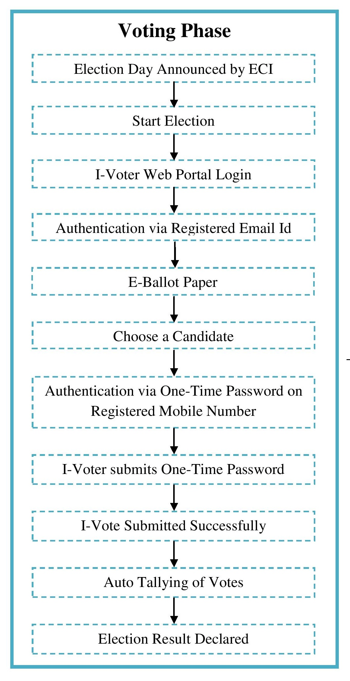
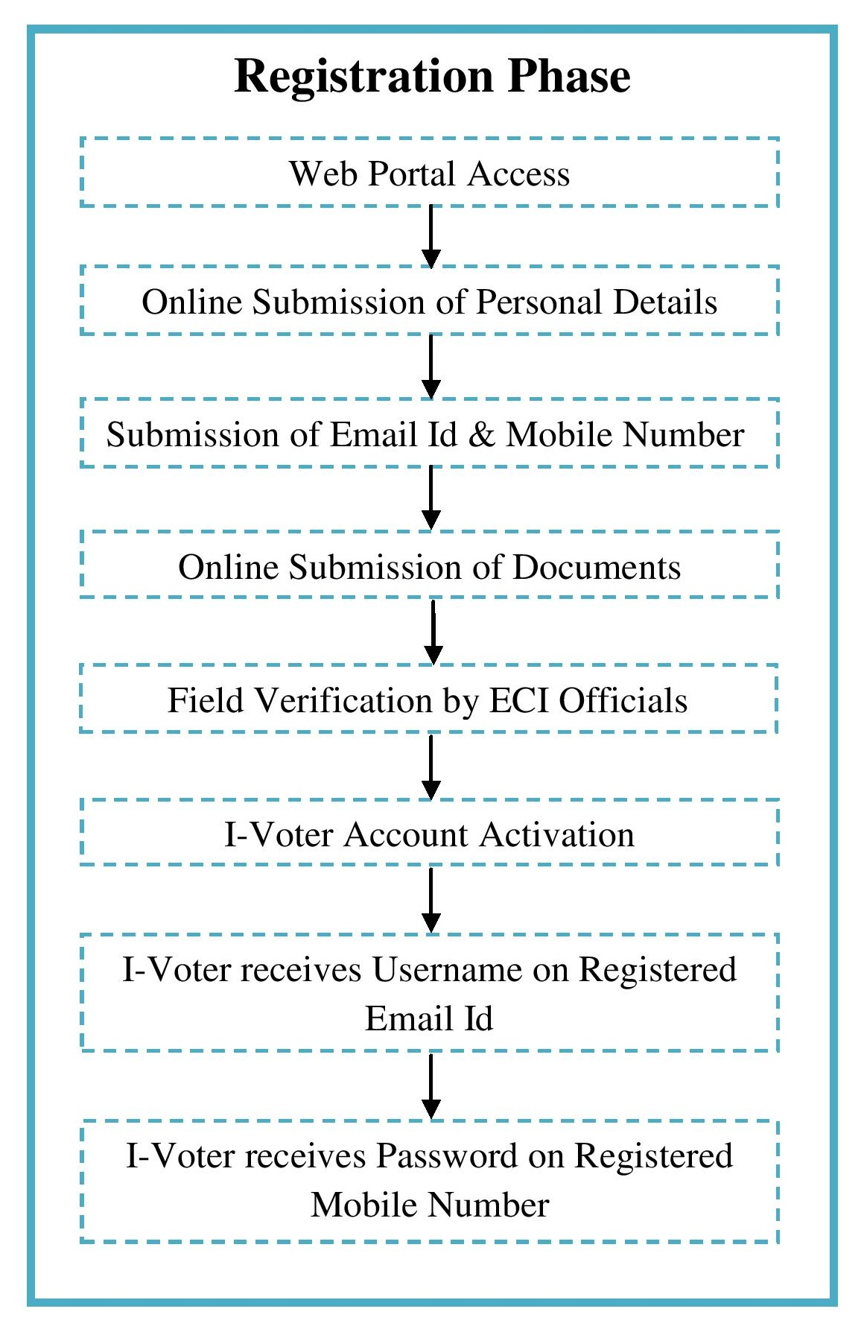
FLOWCHARTS
Fig. 3. Flowchart depicting Registration Phase of I-Voting
Fig. 4. Flowchart depicting Voting Phase of I-Voting

Slide 14
ADVANTAGES OF PROPOSED MODEL
Efficient Data Management: Separate central databases would be created and maintained for storage of I-Voter records and online votes being cast during election. These central databases would be managed by expert technical personnel of Election Commission of India, thus allowing efficient and secure data management.
Scalability: A private cloud promises scalability as it allows addition of extra servers or more processing ability when required by increased business demands.
Database Backup: Cloud virtualization technology enables the creation of cloud data backup and allows for restoration in the event of data loss.
Higher Voting Percentages: As the proposed model provides the voters with an option to cast their vote online through I-Voting channel, thus this is expected to boost the voting percentages.
Mobility: The I-Voting System allows the voters to cast their vote while on-the-go from any location across the country, benefiting those who may be away from their constituency.
Time Saving: The I-Voting System allows the voters to cast their vote in reduced time as compared to the existing EVM Voting System by saving the travelling time to and from the polling booth and the time wasted by standing in long queues.
Localization: The I-Voting Web Portal would be offered in several regional languages of the country, thus introducing localization in the proposed model.

Slide 15
CONCLUSION
The Election Commission of India has recently rolled out a number of ICT-based initiatives, but the advanced ICT technologies such as cloud computing still remain to be exploited to boost voting percentages and modernize the Indian Election Voting System.
This paper proposes the deployment model “Cloud-based Integrated Election Voting System (CIEVS)” that integrates the existing Electronic Voting Machine (EVM) System with the proposed I-Voting System by leveraging the emerging cloud computing technology.
The proposed cloud-based model is expected to offer scalability, cost reduction, reliability and enhanced computing power, in addition to achieving its design objective by boosting the voter participation levels in the Indian Elections.
Cloud computing would accelerate the I-Voting System due to its new architecture and virtualization technology by serving the needs of voters through the use of virtualized computing resources via the Internet.

Slide 16
REFERENCES
[1] Election Commission of India, “Charts of Male/Female Vote Percentage & Number of Electors/PC for General Elections (1951 to 2004),” 2012. Internet: http://eci.nic.in/eci_main/miscellaneous_statistics/Graphs_Voteage_NoofContestants.pdf
[2] G.U. Devi, K. Anusha and G.V. Rajyalakshmi, “An Enhanced e-Voting System in Cloud Using Fingerprint Authentication,” Lecture Notes in Electrical Engineering, Springer Berlin Heidelberg, vol. 279, pp. 1219-1224, 2014. DOI = 10.1007/978-3-642-41674-3_169
[3] M. Patil and V. Pimplodkar, “A Survey on Voting System Techniques,” International Journal of Advanced Research in Computer Science and Software Engineering, vol. 3, no. 1, pp. 114-117, 2013.
[4] A. Bisong and S.M. Rahman, “An overview of the security concerns in enterprise cloud computing,” International Journal of Network Security & Its Applications (IJNSA), vol. 3, no. 1, pp. 30-45, Jan. 2011.
[5] IIIT Hyderabad, India, “Cloud Computing for E-Governance,” White Paper, Jan. 2010. Internet: http://search.iiit.ac.in/uploads/CloudComputingForEGovernance.pdf
[6] Election Commission of India, “Links to pdf E-Roll,” Internet: http://eci.nic.in/eci_main1/Linkto_erollpdf.aspx
[7] Election Commission of India, “Enrol Now Become a Voter,” Internet: http://eci-citizenservices.nic.in/frmmobileverification.aspx?type=FORM6
[8] P.K. Malviya, “E-Voting system using cloud in Indian Scenario,” International Journal of Engineering Science & Advanced Technology (IJESAT), vol. 4, no. 2, pp. 171-175, 2014.
[9] C. Armen and R. Morelli, “Teaching about the risks of electronic voting technology,” in Proceedings of the 10th annual SIGCSE conference on innovation and technology in computer science education, Caparica, Portugal, 2005, pp. 227-231. DOI = 10.1145/1151954.1067508
[10] P. Mell and T. Grance, “The NIST Definition of Cloud Computing,” NIST Special Publication 800-145, pp. 2, Sep. 2011.
[11] D. Zissis and D. Lekkas, “Securing e-Government and e-Voting with an open cloud computing architecture,” Government Information Quarterly, Elsevier, vol. 28, no. 2, pp. 239-251, 2005. DOI: 10.1016/j.giq.2010.05.010.
[12] A. Gupta, P. Dhyani and O.P. Rishi, “Cloud based e-Voting: One Step Ahead for Good Governance in India,” International Journal of Computer Applications (IJCA), vol. 67, no. 6, pp. 29-32, 2013.

Slide 17
THANK YOU !

